Slide 1
AIR COMPRESSOR REVERSE ENGINEERING
Nathan Owen Santoso, Terry Lao, Zoe Hughes, Muhammed Ahmed, Cheuk Yui Chong

Slide 2
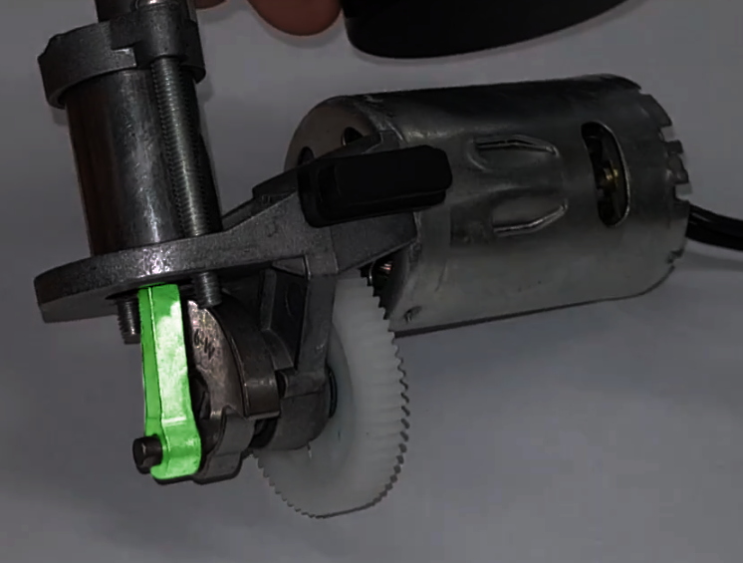
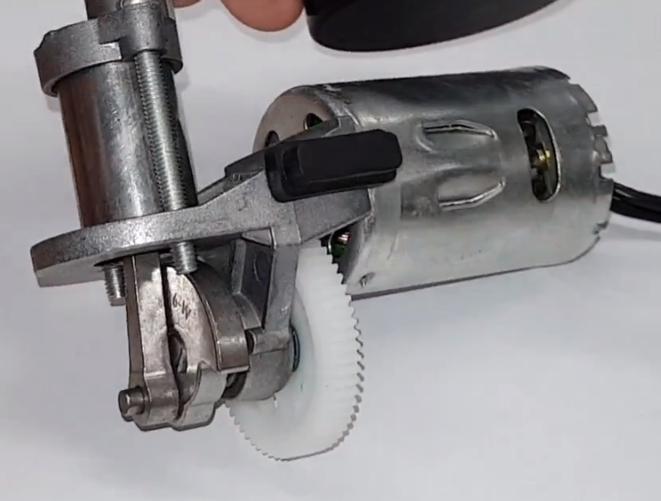
CONNECTING ROD

Slide 3
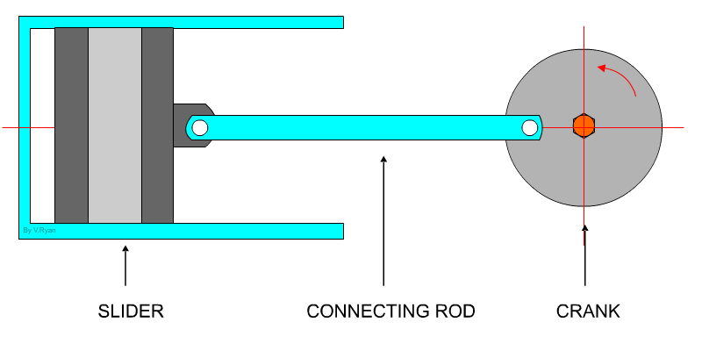
FUNCTION
Connects crankshaft to piston base
Rotational motion
→
Reciprocal motion
http://www.technologystudent.com/cams/crkslid1.htm

Slide 4
MATERIAL
Cyclic stresses
Prone to fatigue failure
Transfer of motion
Minimal plastic/elastic deformation
∴ Not polymer
Critical component
Catastrophic failure unfavourable
Ductility preferred
∴ Not ceramic
Visual resemblance
Silver coloured
Metallic finish
∴ Metal
∴ High strength

Slide 5
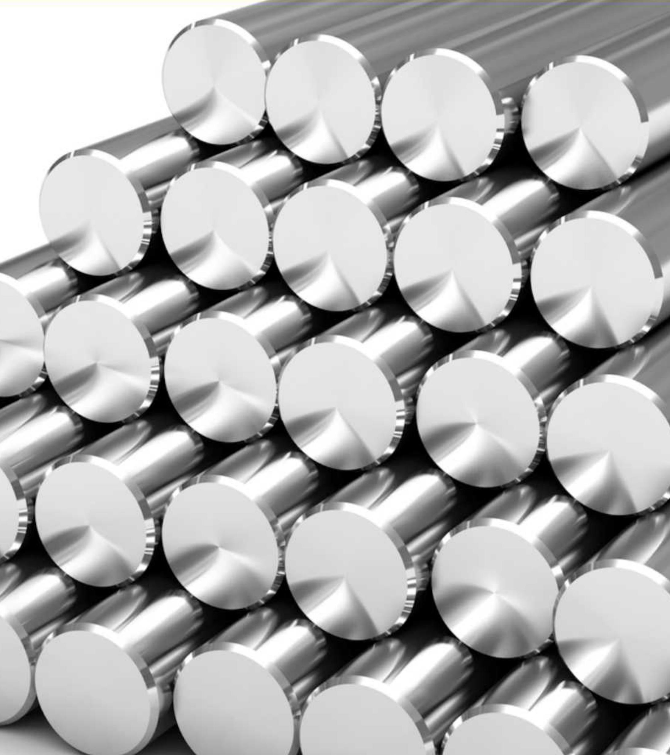
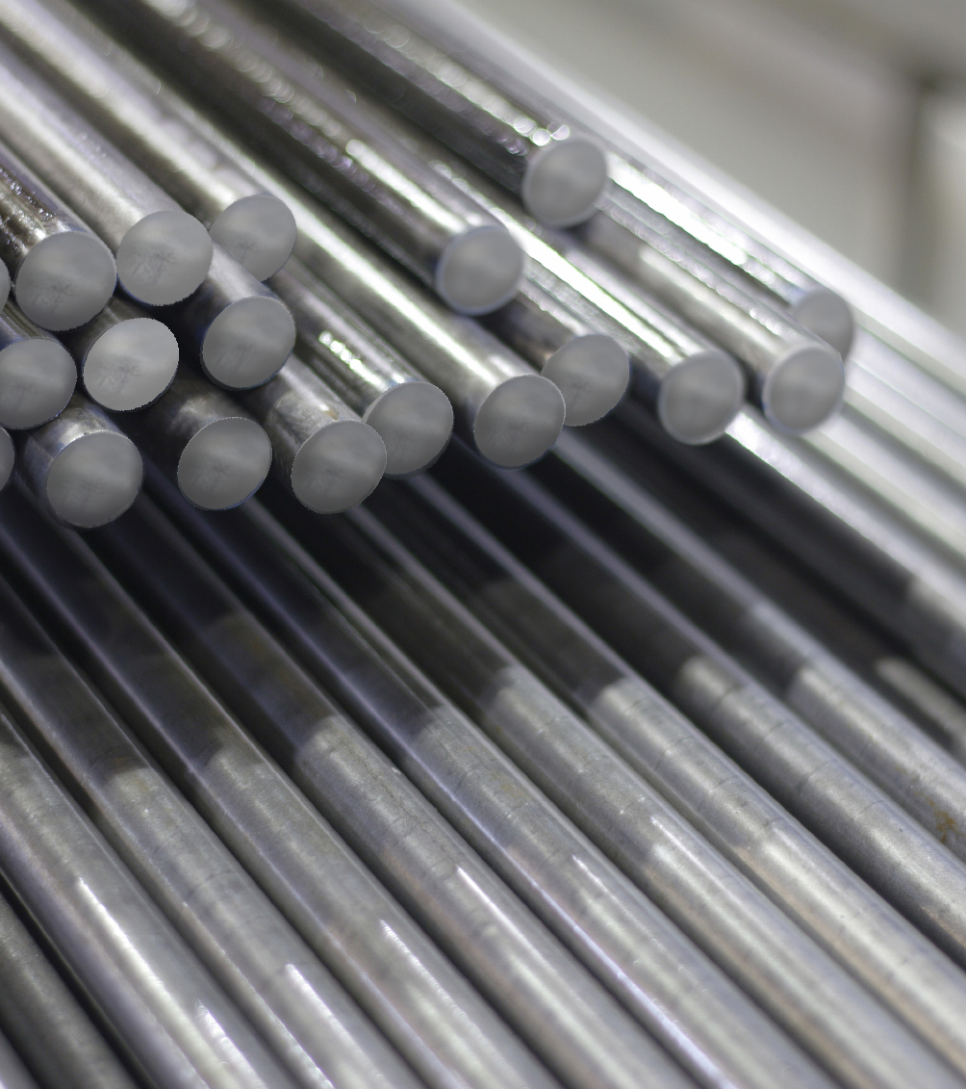
STAINLESS
steel
CARBON
steel
http://autocomponentsindia.com/shree-jay-jagdamba-stainless-steel-plans-expansion-in-capacity-products/
https://www.admiralmetals.com/products-services/carbon-steel-12l14-2/

Slide 6
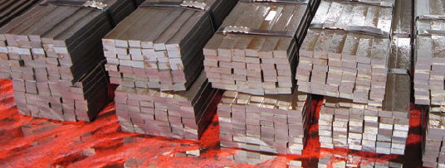
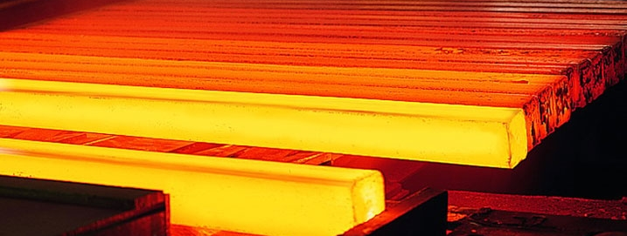
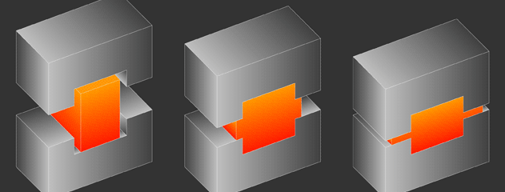
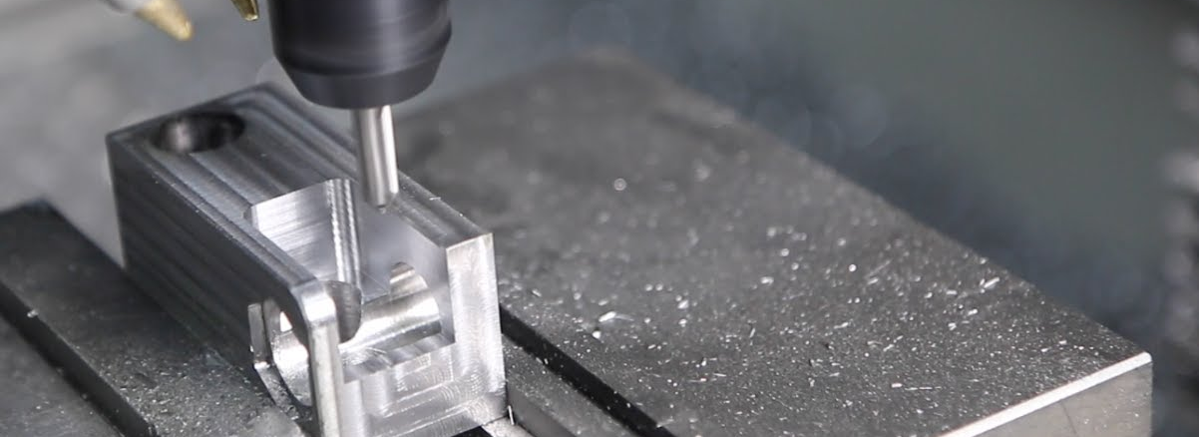
MANUFACTURING
Steel cut into billets
Heated to ~1300C
Impression die forging
Machining
https://image.made-in-china.com/202f0j00AFCtjiOEfDqf/Cold-Drawn-Small-Steel-Billet-Various-Shape.jpg
http://www.steadfastfze.com/images/steel_hot_billets_rod.jpg
http://s177546276.onlinehome.us/Images/forging_impression-Final.gif
https://i.ytimg.com/vi/hoD6gzUHpns/maxresdefault.jpg

Slide 7
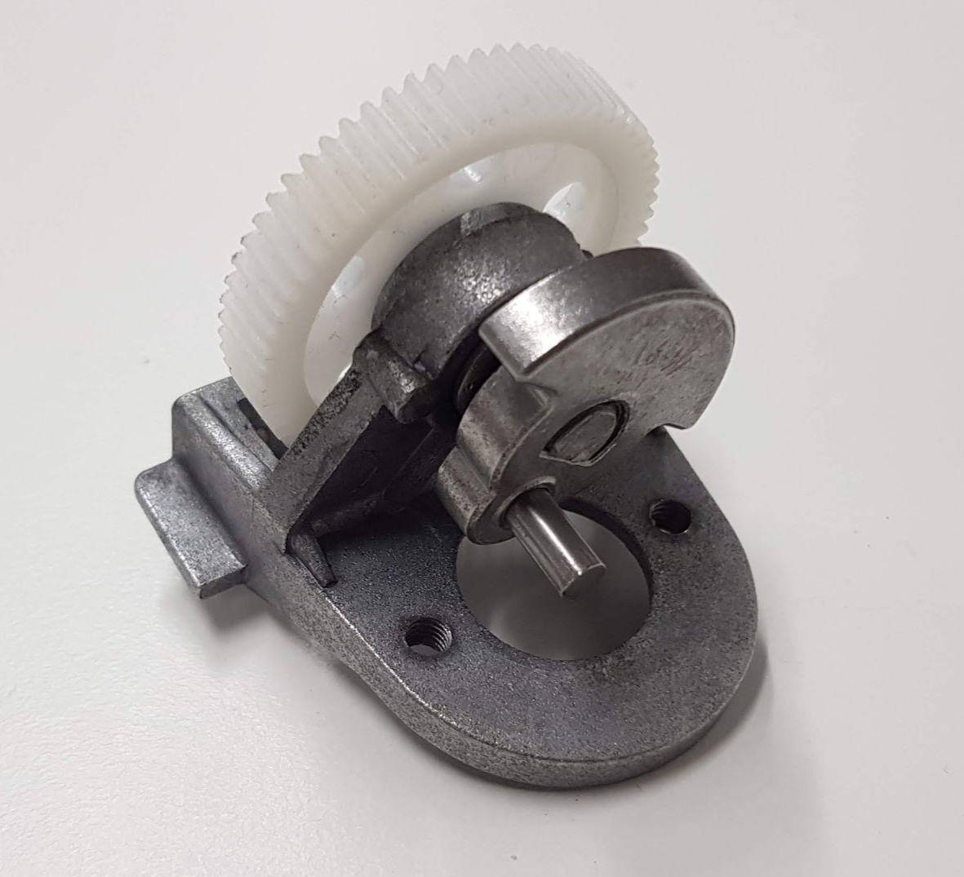
COUNTERWEIGHT

Slide 8
Function
Provides Balance and stability
Increases efficiency
Saves energy
Allows movement with lower driving forces
Reduces vibrations allowing the system to rotate smoothly

Slide 9
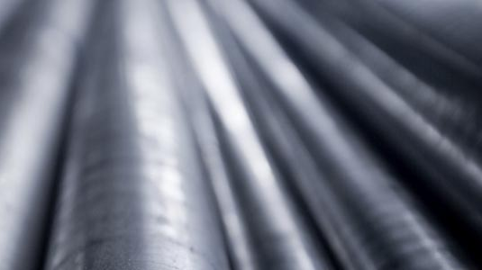
Material & Properties
Most likely a steel alloy
Close to the budget range (low cost raw material)
Relatively dense
Corrosion of the steel can be prevented by paint coating (cost-effective)
High strength and hardness
http://www.hvsteel.com/SiteFiles/hvsteelcomau/content-banner-tubular-steel-pipes.jpg

Slide 10
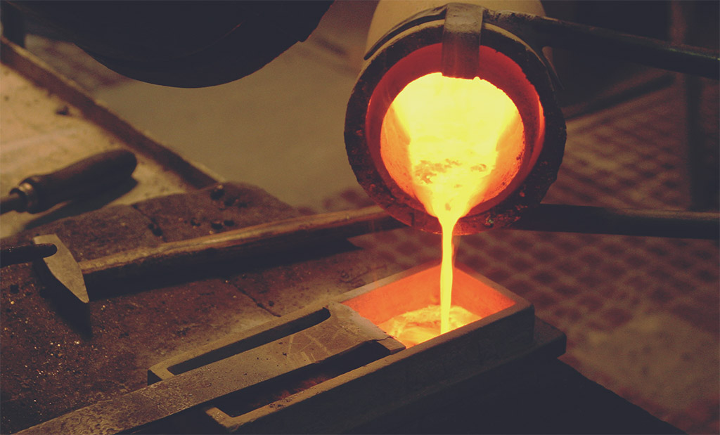
Manufacturing
Die Casting (Hot chamber, Zinc)
Steel mold is sprayed with a lubricant:
Regulates temperature
Easier to remove the cast
Liquefied metal transferred to die through extreme pressure
Mold cooled by immersing or sprayed with cold water
Cast removed
Less metal scraps
Very efficient production with excellent accuracy
http://aarne.co.uk/wp-content/uploads/2017/07/Bronze-Casting.jpg

Slide 11
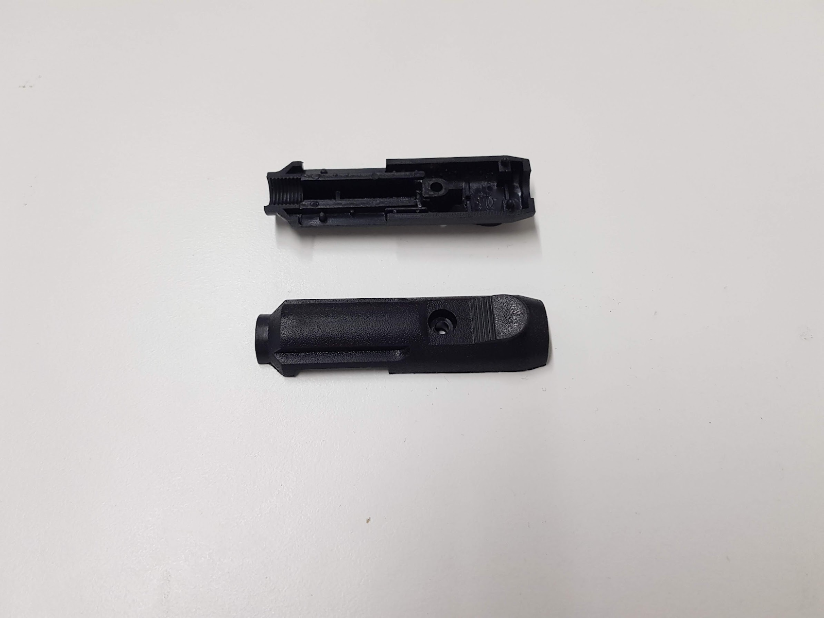
CIGARETTE LIGHTER PLUG HOUSING

Slide 12
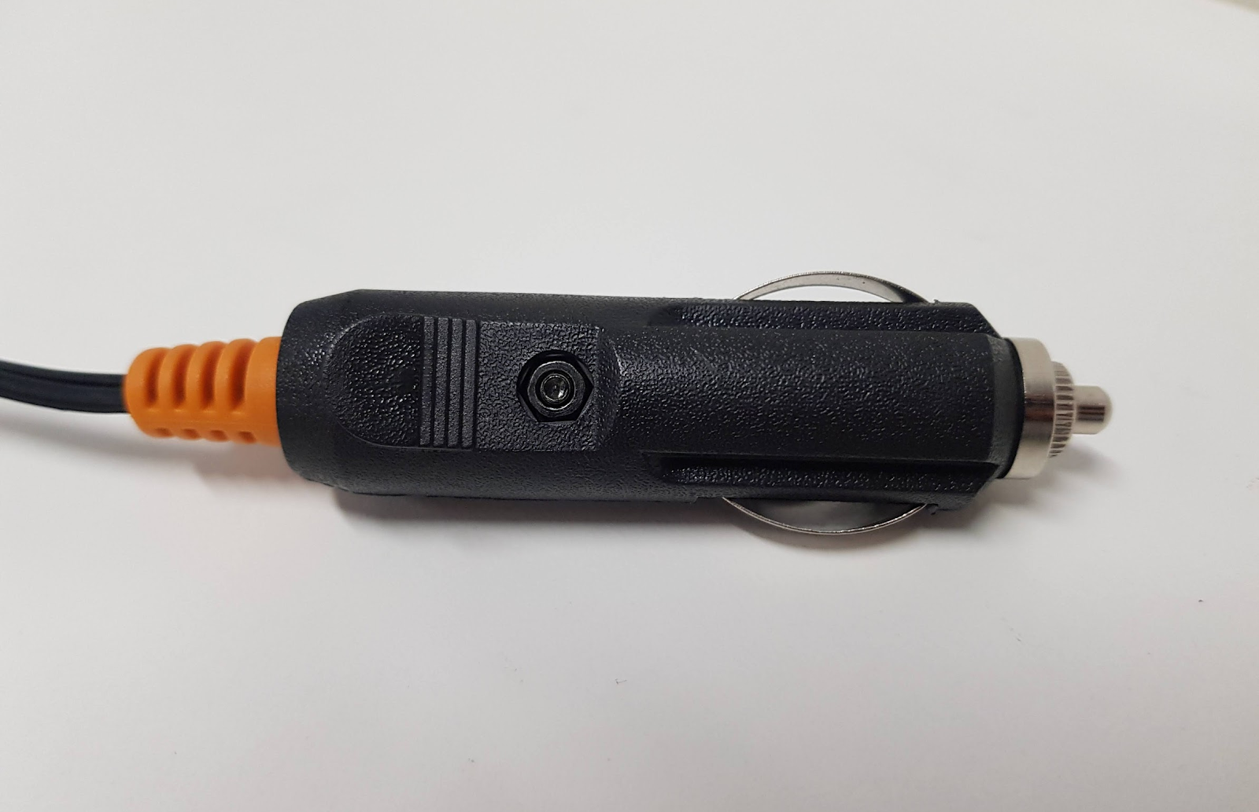
FUNCTION
Act as an insulator
Acid, heat and impact defence
Prevent slipping
Slight water-proofing
Hard Rod Shape

Slide 13
Function | Material properties
Insulating | PVC – Good insulator – No free electrons PVC – Not subject to electrolysis / current corrosion
Acid, heat, impact defence | PVC – Hard – High density polymer chain. PVC – High melting point PVC – Stable – Acid resistance
Protect users | PVC – Thermoplastic – softening if overheated
MATERIAL PROPERTIES

Slide 14
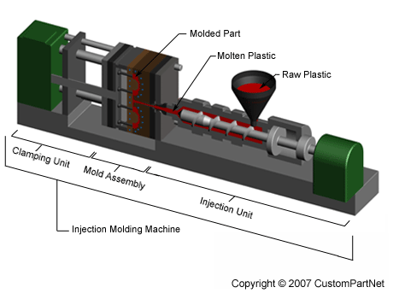
MANUFACTURING
Melt the raw plastic
Fill the injection unit with molten plastic
Inject the plastic to the mold
Apply force to hold the mold
Solidify while cooling
Ejection (with mold release agents)
Trimming
http://www.custompartnet.com/wu/images/im/injectionMolding_machine_overview.png

Slide 15
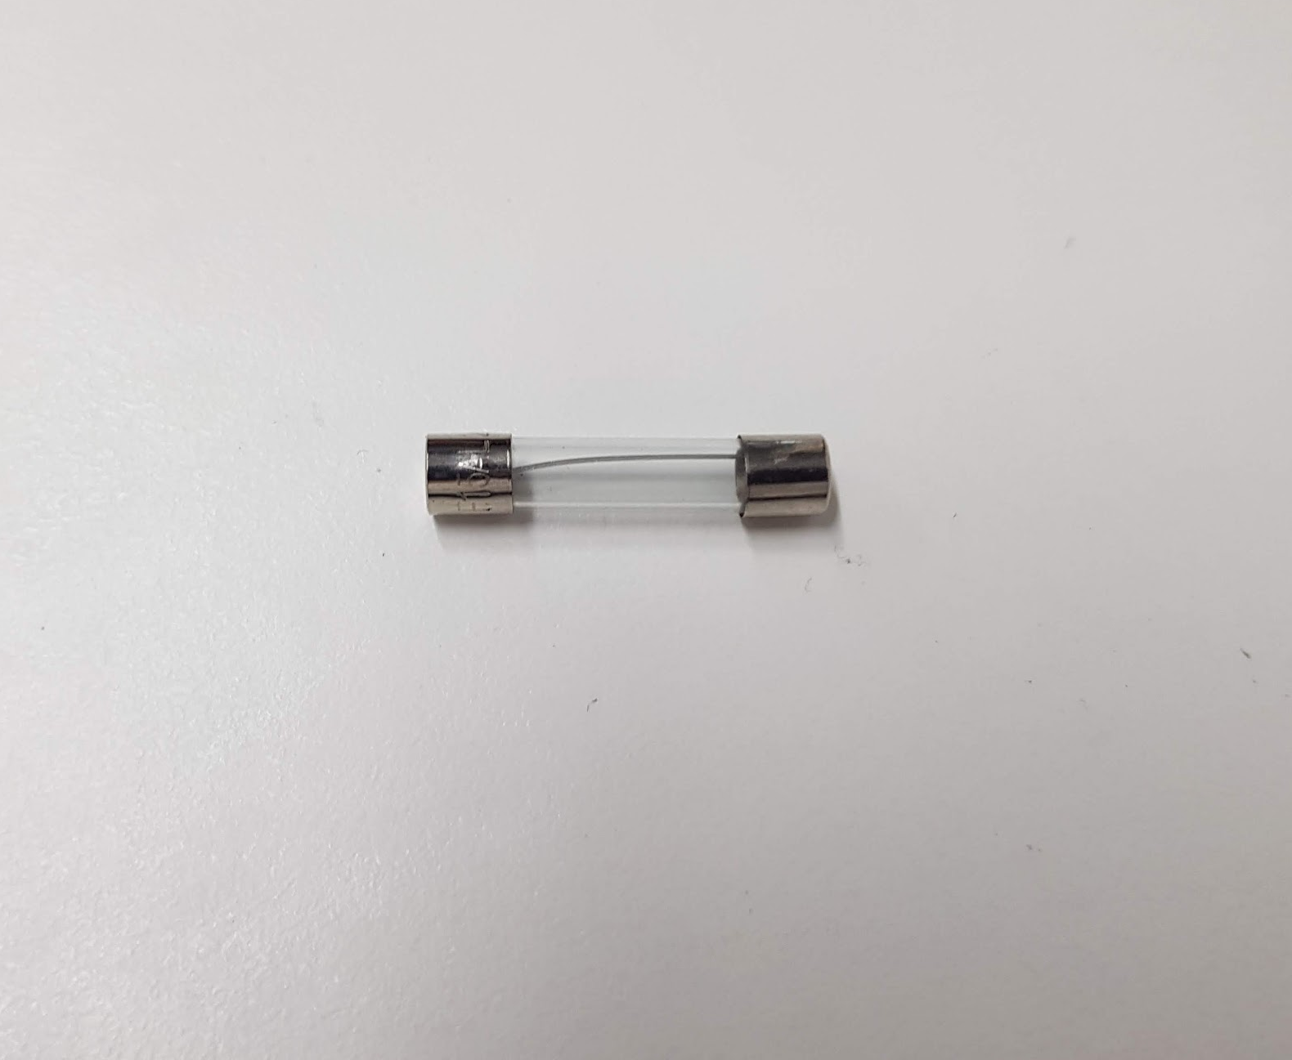
FUSE

Slide 16
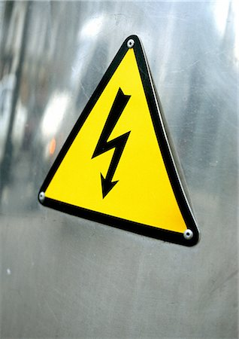
function
Safety feature to prevent overloading of circuit
https://image1.masterfile.com/getImage/Njk2LTAzMzk4ODEyZW4uMDAwMDAwMDA=AHetM6/696-03398812en_Masterfile.jpg

Slide 17
material properties
Element: (Zinc or aluminium alloy)
Conduct electricity
Low melting point
Ductile
Casing: (Glass)
High yield strength
Electrical Insulator

Slide 18
MANUFACTURING
Element
Drawing – process in which the diameter of a stock piece of metal is reduced
Glass
Danner process: molten glass is formed into a tube using a rotating mandrel
Annealing – reduces internal stress in the wire to improve its metallic properties

Slide 19
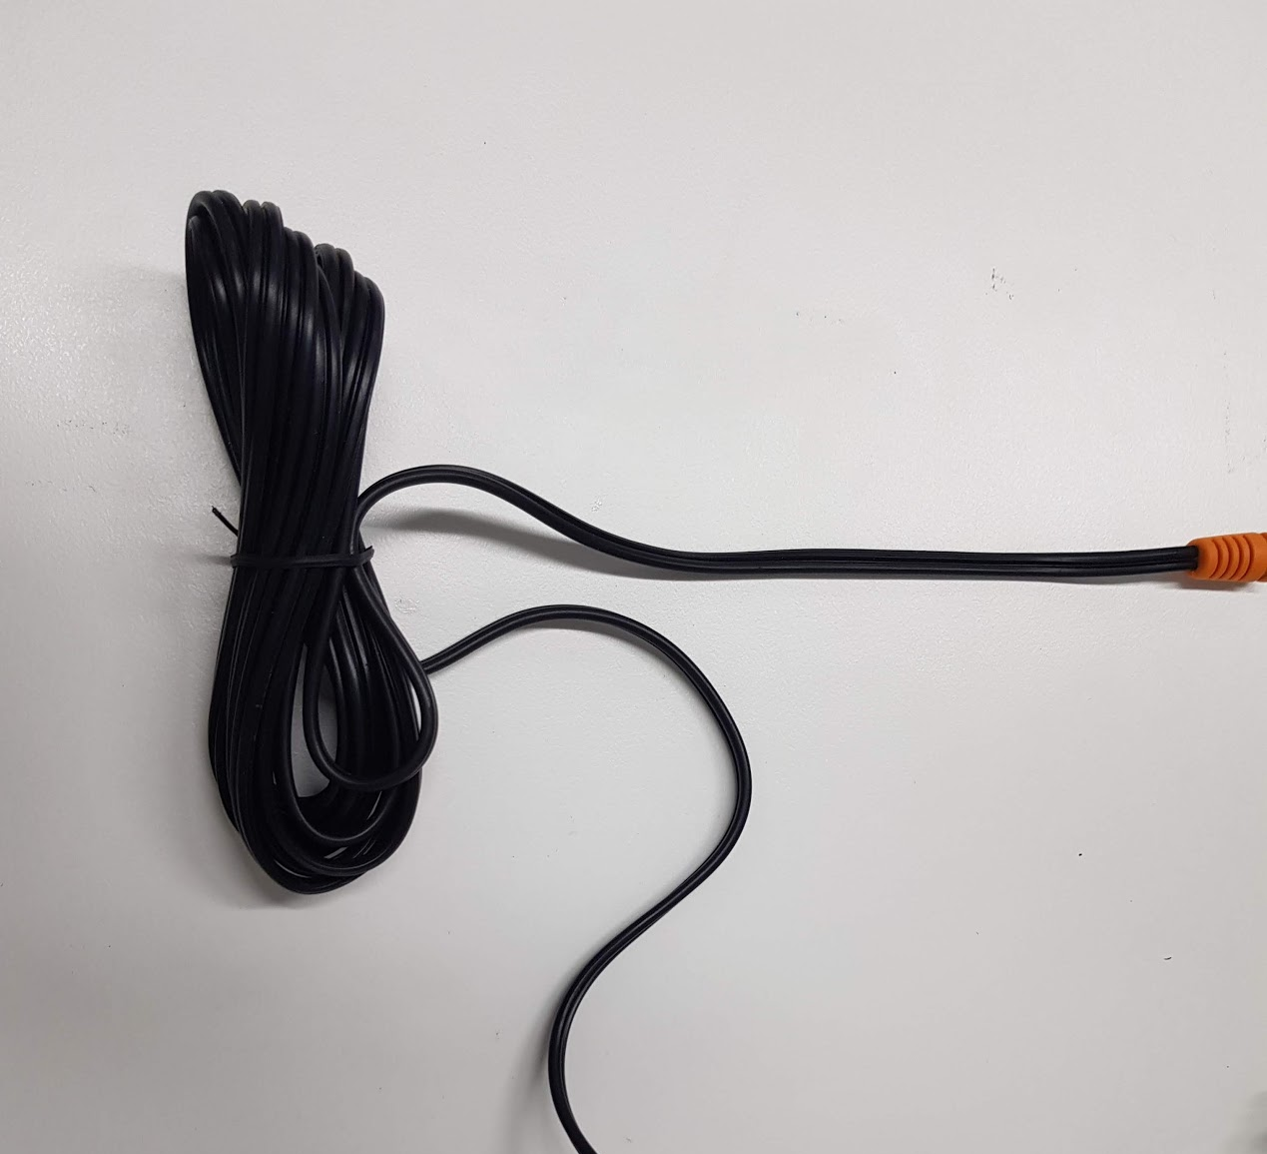
POWER CABLE

Slide 20
Function
Electrical connection to the power supply
Thermal and electrical insulation
Connection to power supply from fair distances

Slide 21
Material
Conducting Material (Copper)
- Cheap, ductile and easily available
- High melting point with low resistivity
- High purity
Insulating Material (PVC)
- Good thermal and electrical insulator
- Flexible
- Cheap and available in bulk quantity
- Ability to withstand frequent wear and tear

Slide 22
Manufacturing
First
- Reduction of diameter of wire
- Increase in its ductility and conductivity
Second
- Annealing
- Removal of internal stresses
- Increase in conductivity
Third
The wire is insulated
- Increase in toughness

Slide 23
bibliography
‘Forging vs Casting’, Compass & Anvil, [website], 2012, https://www.compass-anvil.com/forging-vs-casting, (accessed 25 Aug. 2018)
‘Hot Forging of Connecting Rod’, CFS Steel Forging, [website], 16 June 2018, http://www.steelforging.org/hot-forging-of-connecting-rod/, (accessed 26 Aug. 2018)
Duan, M., ‘How to Forge the Connecting Rod’, LinkedIn, [web blog], 28 June 2017, https://www.linkedin.com/pulse/how-forge-connecting-rod-michael-duan, (accessed 25 Aug. 2018)
Greenhaw, E., 'How An Electrical Cable Is Made', ECNMAG, [website], 2016, https://www.ecnmag.com/blog/2016/04/how-electrical-cable-made (accessed 2 Sept. 2018)
Fuses: Chapter 12 - Physics of conductors and insulators, [website], https://www.allaboutcircuits.com/textbook/direct-current/chpt-12/fuses/, (accessed 26 August 2018)
Metal Casting Process, [website], https://thelibraryofmanufacturing.com/metalcasting_basics.html, (accessed 26 August 2018)
Steel material properties, [website], https://www.steelconstruction.info/Steel_material_properties, (accessed 27 August 2018)
Wiley, J. Fundamentals of Modern Manufacturing, [website], 2002, http://www.me.nchu.edu.tw/lab/CIM/www/courses/Manufacturing%20Processes/Ch12-Glassworking-Wiley.pdf, (accessed 27 August 2018)
Tube Glass: Danner Process, [website], https://www.eurotherm.com.au/tube-glass, (accessed 27 August 2018)
‘Everything you Need to Know About PVC Plastic’, Creative Mechanisms, [web blog], 6 July 2016, https://www.creativemechanisms.com/blog/everything-you-need-to-know-about-pvc-plastic, (accessed 20 Aug. 2018)
‘Injection Molding’, Custompartnet, [website], 2007, http://www.custompartnet.com/wu/InjectionMolding, (accessed 20 Aug. 2018)
‘Counterweights information’, IEEE Global Spec, [website], https://www.globalspec.com/learnmore/mechanical_components/industrial_hardware/counterweights, (accessed 3 Sep, 2018)
‘Die Casting vs. Injection Molding: Pros and Cons’, National molding, [website], https://nationalmolding.com/blog/die-casting-vs-injection-molding-the-pros-and-cons/, (accessed 3 Sep. 2018)
‘Die Casting’, Dynacast International Inc, [website], https://www.dynacast.com/die-casting, (accessed 3 Sep. 2018)

